Slide 1
SMART GREEN HOUSE SYSTEM
Anjumfiza Shaikh -102
Krushna Garkal-113
Puja Pardhi-127
Rutika Utage-133
Guided by-
Vinod Palkhe

Slide 2
CONTENT
Introduction
Need
Problems faced in Agricultural sector
Green house system
Advantages
Future
Components
References

Slide 3
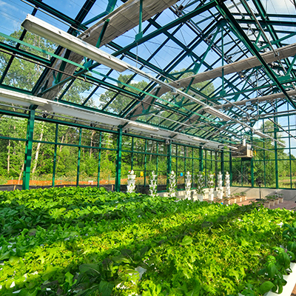
INTRODUCTIon
Greenhouses are the places where organized crop production took place. The governor of temperature, air humidity, light intensity, soil moisture, amount of carbon dioxide and wind velocity by specialists influence productivity
Greenhouse farming is a technique that enhances the yield of crops, vegetables, fruits etc. Greenhouses control environmental parameters in two ways; either through manual intervention or a proportional control mechanism.
Today’s rising demands related to greenhouse for crop production and quality and this system have significantly increased the utilization of high quality and productivity of greenhouse
A smart greenhouse through IoT embedded systems not only monitors intelligently but also controls the climate. Thereby eliminating any need for human intervention.

Slide 4
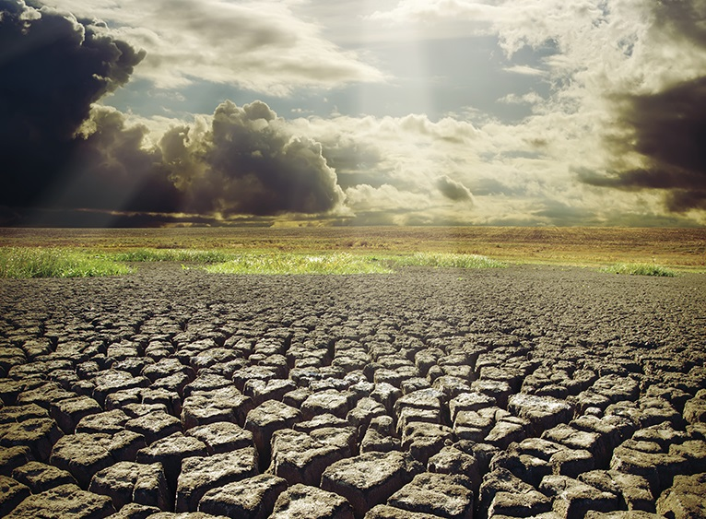
Need
Greenhouse farmer can faces number of problem of environmental condition such as humidity, temperature, water level. Greenhouse farmers cannot precisely detect level of humidity, temperature, water inside the green house. They only know the condition inside the greenhouse manually and feel it by themselves.
In greenhouse plants and crops require certain conditions for their proper growth. Over the years the greenhouse systems became more reliable but with increased complexity.
Improved crop productivity , accuracy in work, idea about the real time condition of greenhouse atmosphere ,reduced farmer effort so we can implemented ‘‘smart greenhouse system’’ as proposed system.

Slide 5
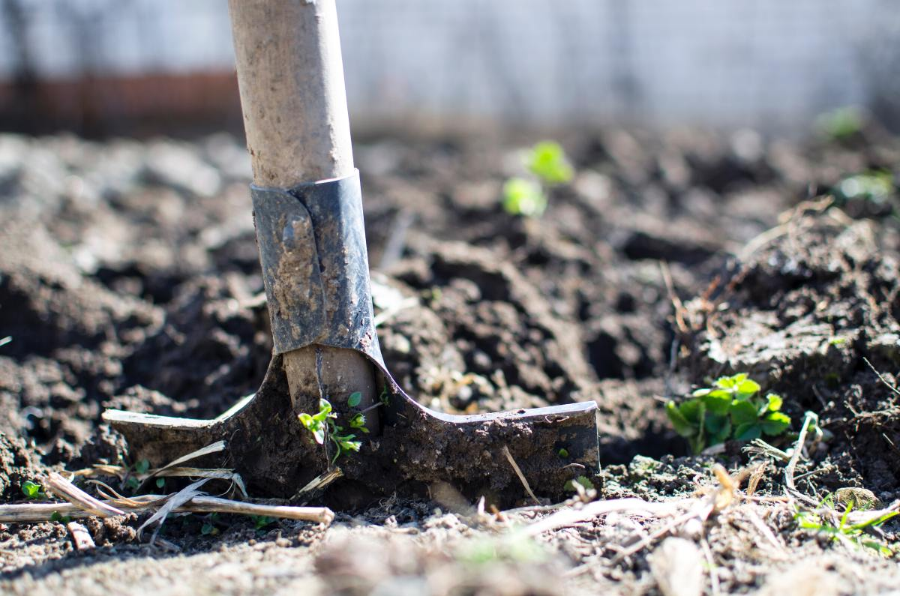
Problems faced in agricultural sector
Excessive use of fertilizers, insecticides and pesticides makes the soil dependent on them, erodes fertility, in-creases resistance in insects and pests, pollutes groundwater and nearby water bodies whenever it rains.
Different plants require different amount of moisture, humidity, temperature and light wavelength, and lack of awareness of this information or negligence of a person cultivating land can cause plants to die before maturing.
The request for food has been growing day by day meanwhile the world population has been rising. It is noticeable that the agricultural products have to be enlarged in order not to be faced with starvation and people needs of foods.

Slide 6
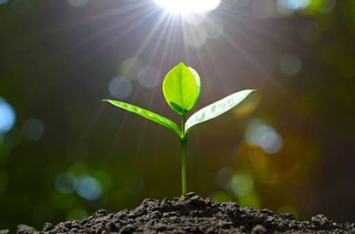
Smart Greenhouse System
Plants found in greenhouse is affected by various factors, such as water in soil, and climatic conditions.
Smart Greenhouse System monitors these parameters by controllers and various sensors like LDR, Temperature sensor, humidity sensor, etc.
Different sensors that measure the environmental parameters according to the plant requirement are used for controlling the environment in a smart greenhouse.
Automation of greenhouses has proved to be extremely helpful in maximizing crop yields and minimizing labor costs. The optimum conditions for cultivating plants are regularly maintained by the use of programmed sensors and actuators with constant monitoring of the system.

Slide 7
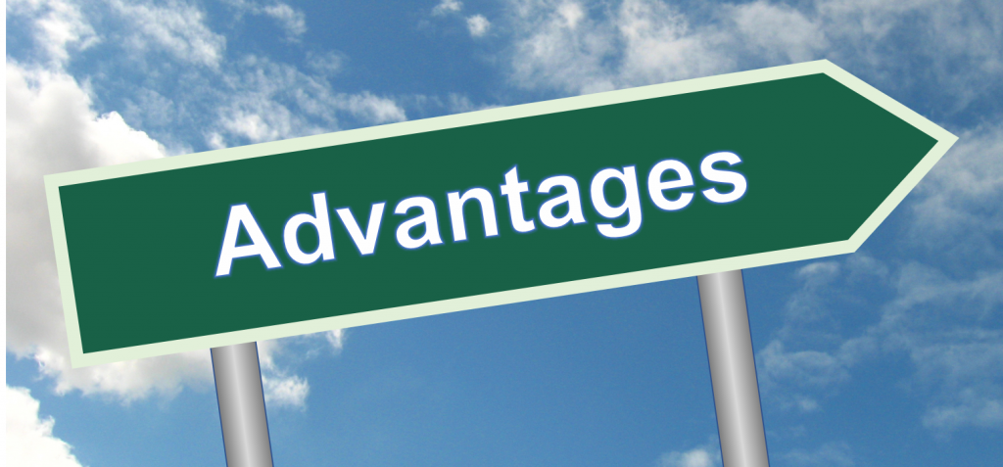
Advantages
Longer Growing Season: Temperatures don’t vary as much within a greenhouse, since the sun’s radiation is trapped in the enclosure, retaining the heat within the structure.
Protection from Pests and Predators: Smaller pests, like certain rodents, can be kept out with the addition of traps and screens.
Protect Plants from Bad Weather: Bad weather like high winds, dust storms, thunder storms and blizzards can all cause damage. However, a greenhouse offers plants a layer of protection from the elements.
Create the Optimum Growing Environment: Creating an optimum growing environment helps you to enhance the growth of plants, giving you the benefit of healthier, better producing plants.

Slide 8
Advantages
Grow Plants without Dangerous Pesticides: It’s possible to grow plants without all those dangerous, toxic pesticides when growing in a greenhouse. Gardeners can control what they use when growing their own produce.
Easily Customize the Greenhouse to Your Needs: When you build a greenhouse, you have the ability to easily customize it to your needs.
Save Resources: When using a greenhouse, it’s possible to conserve energy sources like water, since these energy sources can more easily be controlled as opposed to traditional gardening.

Slide 9
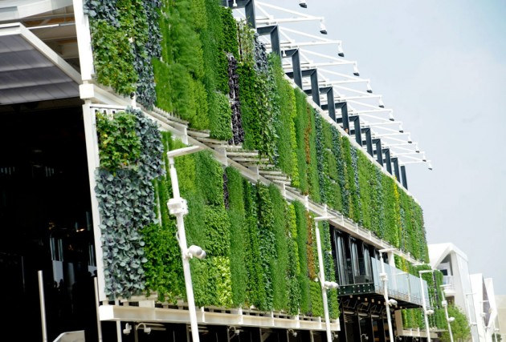
Future
• To create professional Smart greenhouse system • To reduce harmful habits to the environment at the result of the using alternative and renewable energy sources • To save water resources as a result of smart management • To make compost fertilizers from fruit, vegetable and plant origin wastes from household wastes • To apply management and sorting system of household wastes in the region

Slide 10
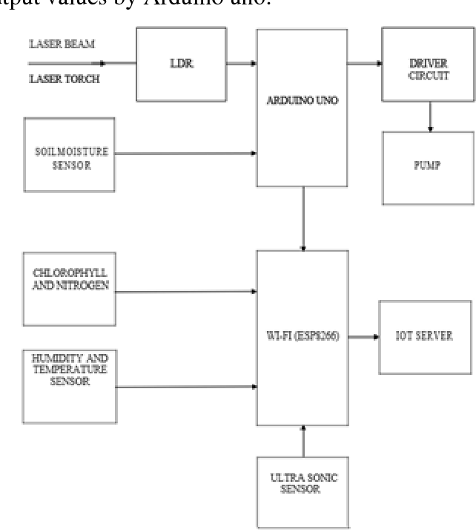

Slide 11
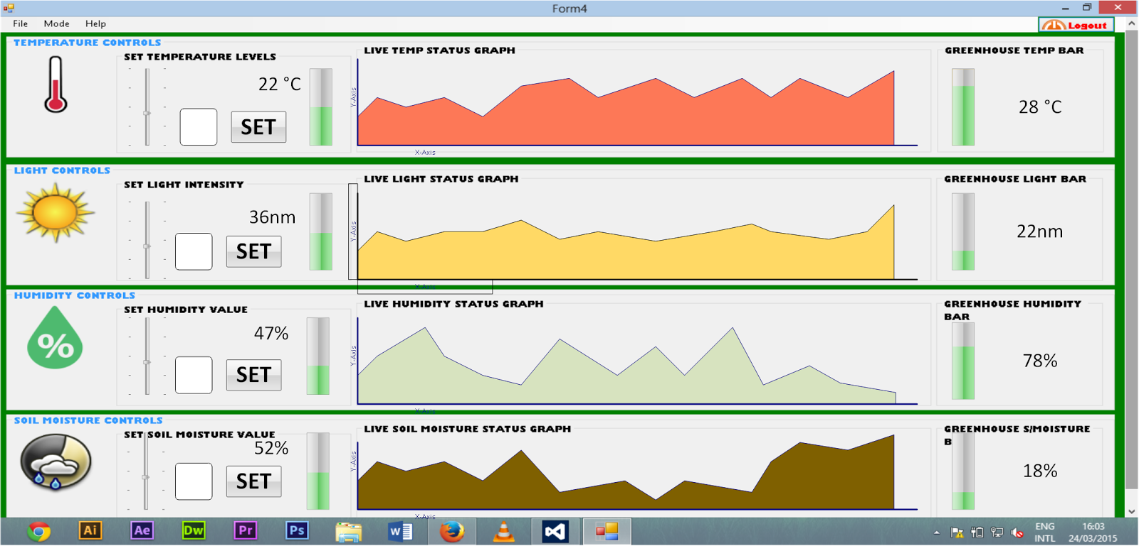

Slide 12
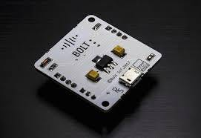
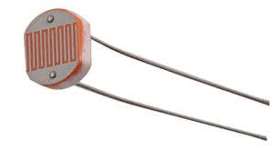
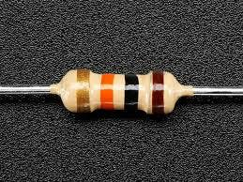
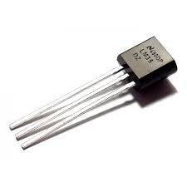
COMPONENTS
BOLT WIFI MODULE
LDR
10K RESISTOR
LM 315

Slide 13
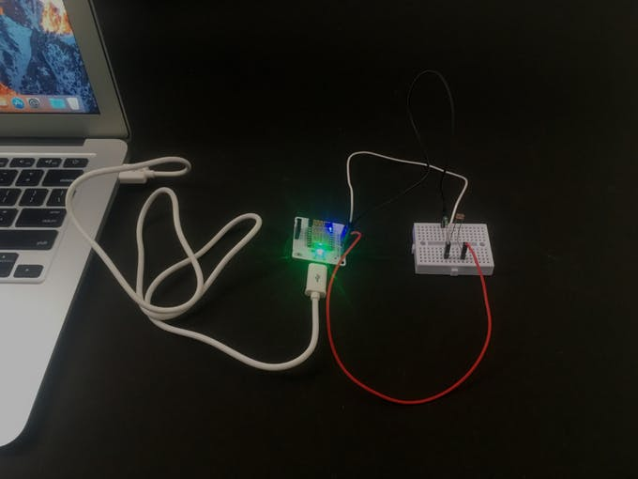
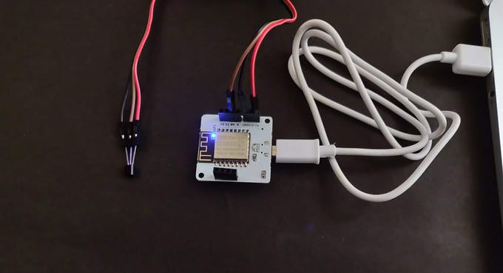

Slide 14
CONCLUSION
The temperature , intensity of light , humidity values are sent to the cloud .
Proper values are set according to the type of plant .
We can draw graphs of variations in these parameters using Visualization data from cloud
Any undesirable change in climatic conditions is notified immediately .
Plants are protected from adverse climatic conditions.

Slide 15
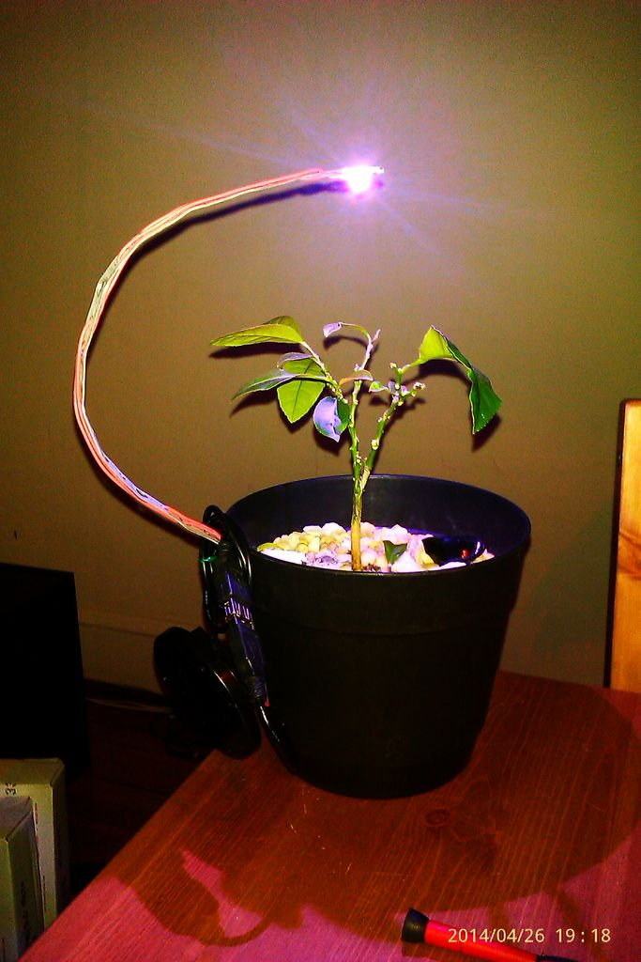
An example of artificial light for plants

Slide 16
References
https://ijcsmc.com/docs/papers/August2015/V4I8201560.pdf
https://www.researchgate.net/publication/316448621/download\
https://www.scribd.com/document/334848424/Smart-Greenhouse-System

Slide 17


